Slide 2

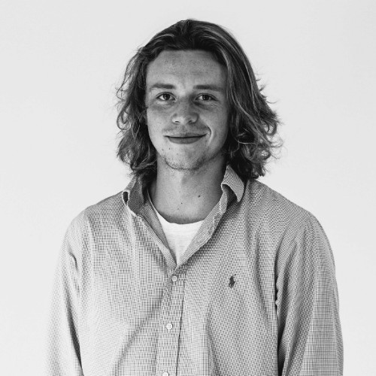
ITV Wellbeing Matters
Lucy Irving
Senior Cultural Strategist
ITV’s Client Strategy & Planning
Tom Anderson
Creative Strategist
Notes:
Wellbeing is one of the fastest growing industries in the UK, with brands increasingly exploring how they can influence their customers' wellbeing. But in a time where wellbeing is a part of everything and anything, it’s also difficult to get it right.
ITV has produced and been home to some of the biggest mainstream wellbeing campaigns of the past decade. From Britain Get Talking, Eat Them to Defeat Them, Bowel Babe and the Menopause bus.
This research was commissioned to codify what we at ITV have learnt about wellbeing from our audiences, campaigns and our research partners to help brands talk about wellbeing better.

Slide 3
ITV Wellbeing Matters
Cultural truths
Macro Trends
Micro Trends
ITV’s approach to understanding culture
Cultural Moments
Signals

Slide 4
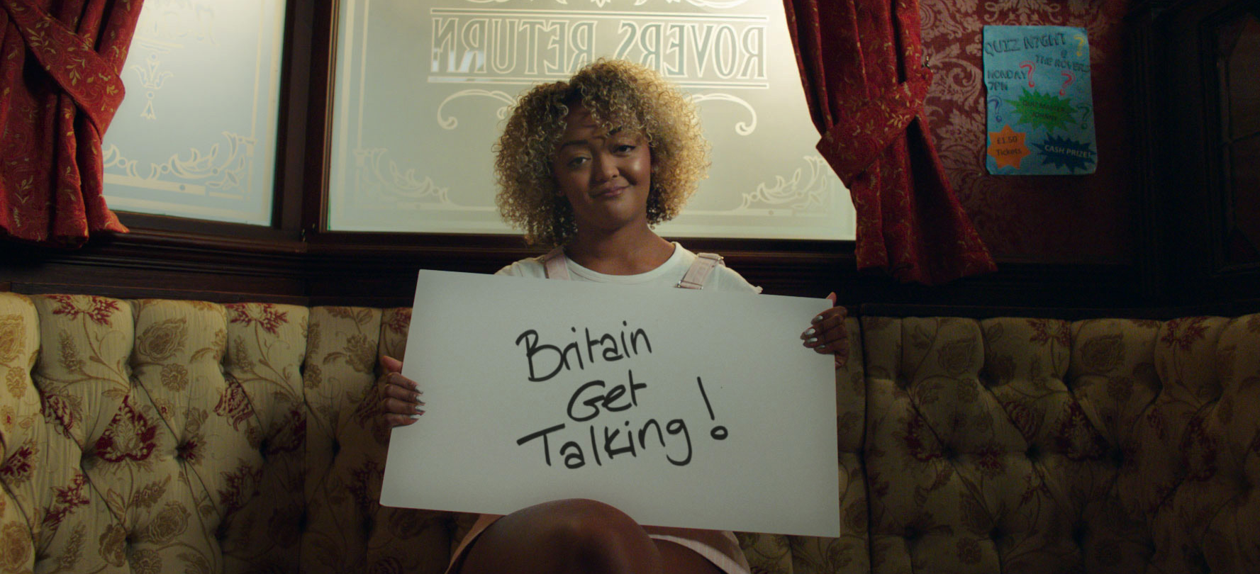
ITV Wellbeing Matters
Why wellbeing?

Slide 5

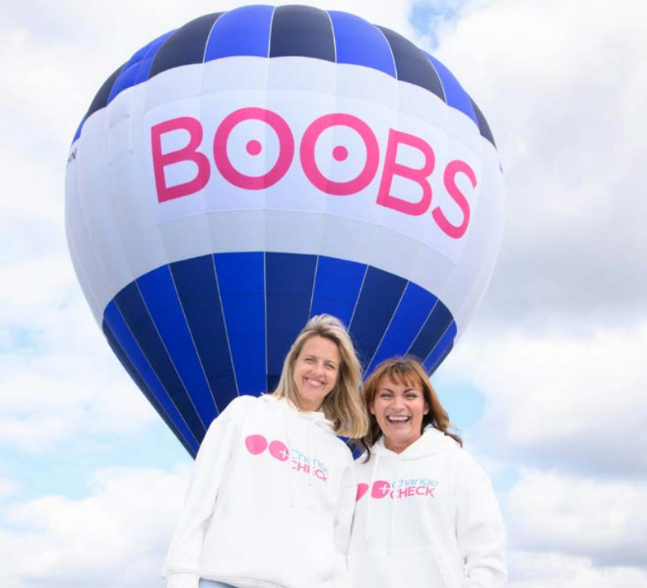
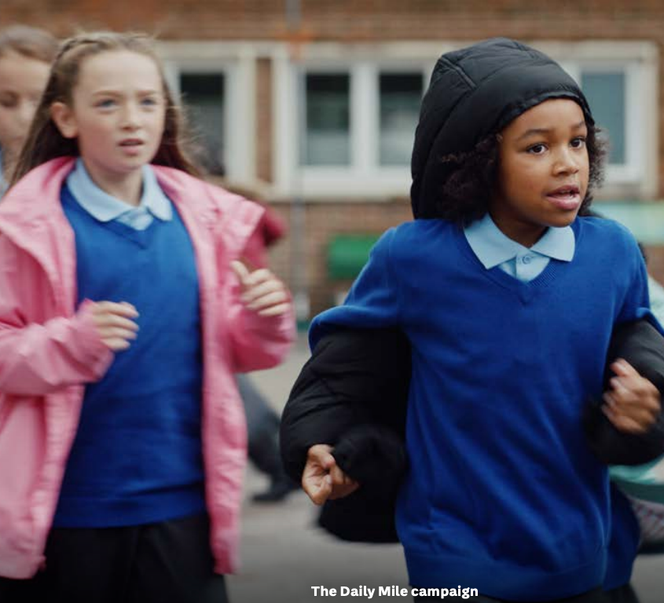
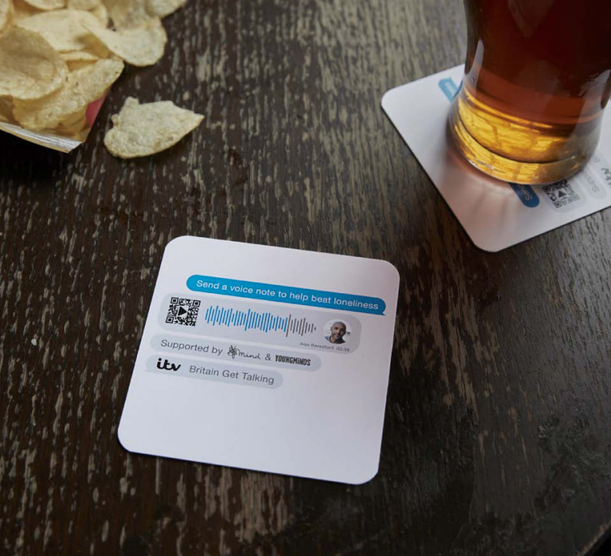
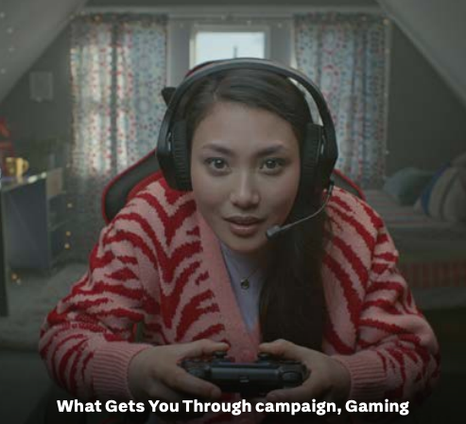
ITV Wellbeing Matters

Slide 6

ITV Wellbeing Matters
“We think about wellbeing as better mental and physical health and we fully recognize that there are overlaps. The ITV focus has always been looking at what we can do to look after our viewers health”
Susie Braun, ITV Head of Social Purpose

Slide 7
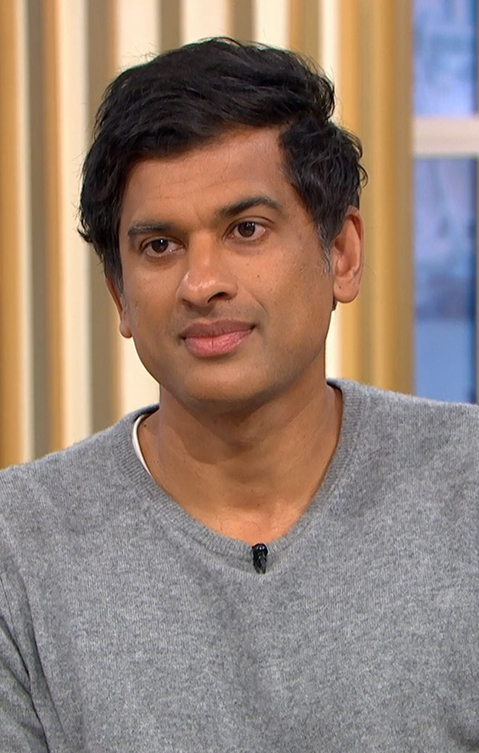
ITV Wellbeing Matters
How we conceptualise wellbeing
1
Movement
2
Healthy eating
3
Sleep
4
Stress relief

Slide 8
ITV Wellbeing Matters
Our aim
Help brands talk about wellbeing better.

Slide 9
ITV Wellbeing Matters
400 ITV Villagers
8 Deep dives
The research in numbers
2 Nat rep data sets
3 Wellbeing experts

Slide 10
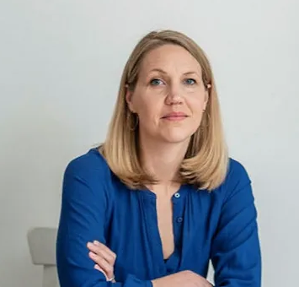
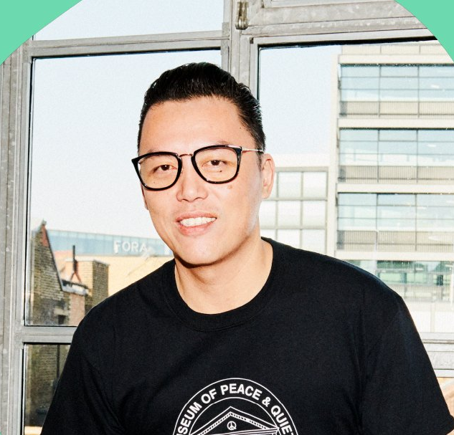
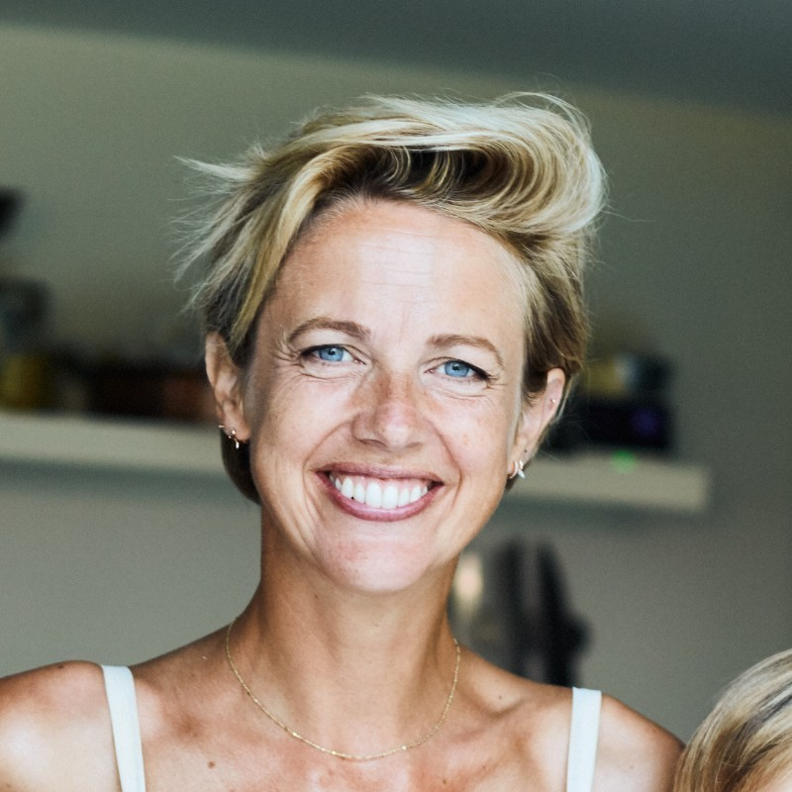
ITV Wellbeing Matters
Susie Braun
Head of Social Purpose, ITV
Stephen Mai
Leveraging
ITV’s wellbeing experts
Founder
Woo, ITV
Helen Addis
Features Editor, Lorraine
& Breast cancer activist

Slide 11
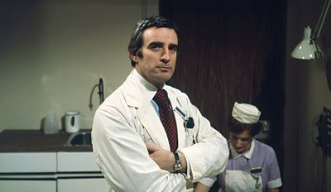

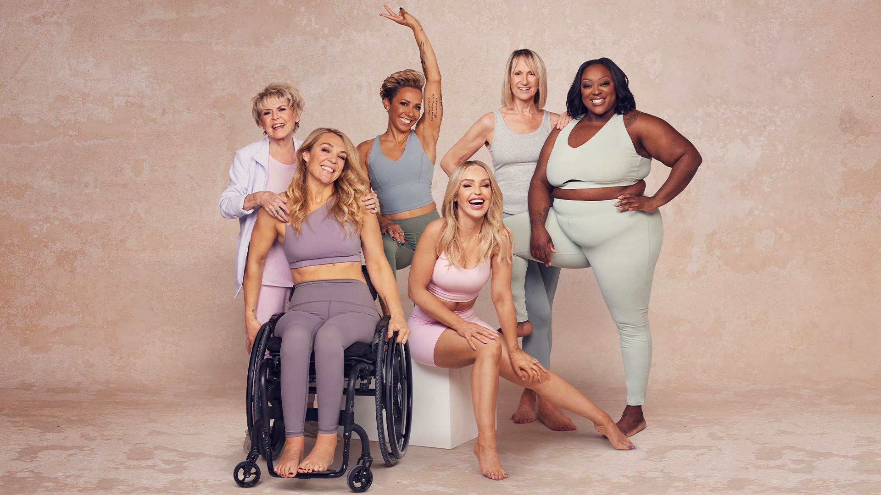
ITV Wellbeing Matters
A significant shift in how we conceptualise wellbeing
Then
Institutional
Now
Individual
Next
Communal

Slide 12
ITV Wellbeing Matters
What’s impacting our wellbeing
Economic
The cost of living
Cultural
Tech creep
Personal
Crisis in confidence

Slide 13
ITV Wellbeing Matters
“Now it’s sort of not trying to be as well as well can be, it’s trying to keep my health as it is and work within my limitations, so I’m constantly having to re- evaluate what wellness is”
Female, 54, Brighton

Slide 14
ITV Wellbeing Matters
“Health to me is can you just go through your day and general life without difficulty ….and wellbeing is ‘can you make it through the day?”
Male, 29, Wales

Slide 15
ITV Wellbeing Matters
“No one has the time to spend 3 hours in the gym and I hated that side of social media. The toxicity of you can look like me if you follow what I did and like I can’t follow what you did, because I
don’t have the time that you do”
Male, 23, Northern Ireland

Slide 16
ITV Wellbeing Matters
“I think health and well being has been sort of almost pushed aside. An awful lot. I think, because obviously that post Covid and things at that, people that just trying to get back into working in the whole working mentality that they feel they’ve got to do a lot of catching up.”
Female, 41, Bristol

Slide 17
ITV Wellbeing Matters
“If brands spoke to people, they’d know what people actually need. If they don’t need it on a day-to-day basis they’re not going to buy it.”
Female, 21, Bradford

Slide 18
ITV Wellbeing Matters
“I do believe that we are responsible for our own health and wellbeing at the end of the day, you know you are what you eat, you’ve got to fuel your body well, you’ve got to do things for yourself, you’ve got to do your research you can’t expect everyone else to do it for you.”
Female, 63, Harrogate

Slide 19
ITV Wellbeing Matters
Natural rejuvenation Finding healing in nature
Cathartic release Easing the pressure together
Health-conscious hedonism Easing the pressure together
Daily preservation Aiming for just enough
5 behavioural pillars of mainstream wellbeing How to tap into them
Exploration & experimentation Questioning the status quo

Slide 20
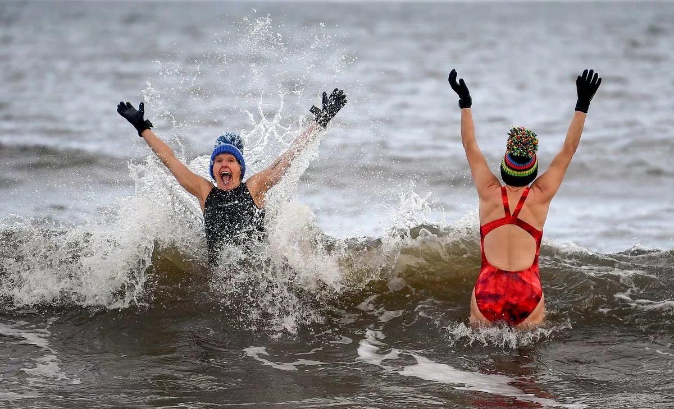
ITV Wellbeing Matters
Natural rejuvenation
Finding healing in nature

Slide 21
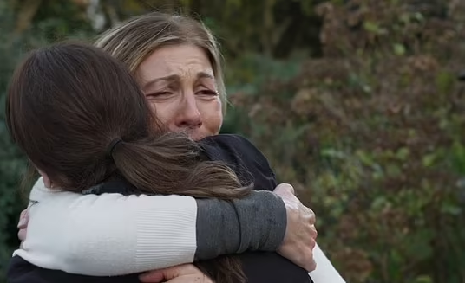
ITV Wellbeing Matters
Cathartic release
Easing the pressure, together

Slide 22
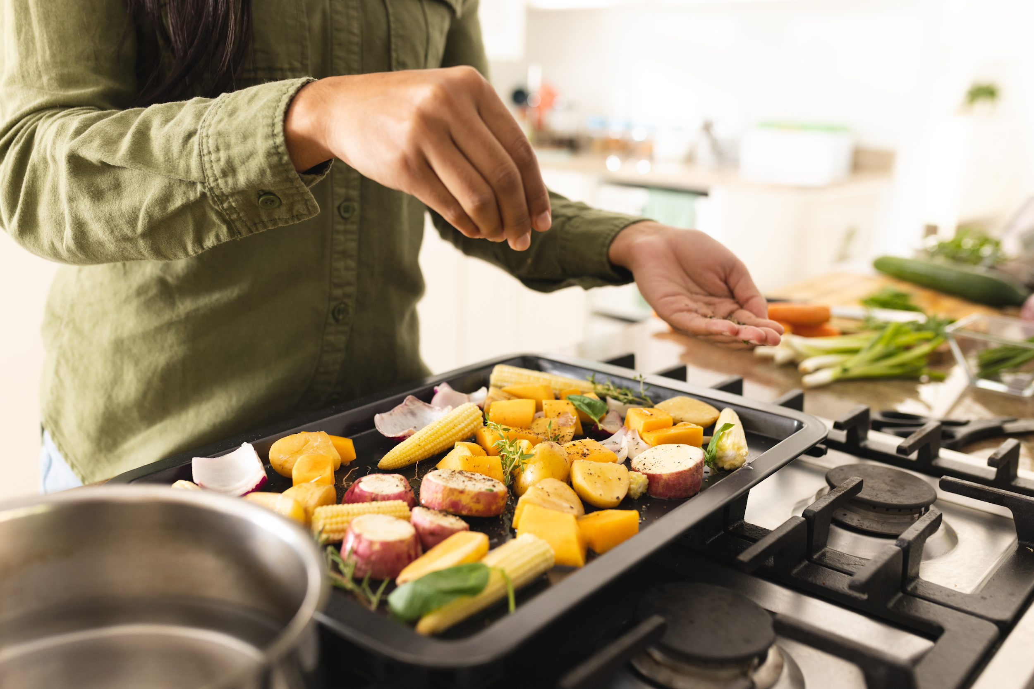
ITV Wellbeing Matters
Health-conscious hedonism
Not giving up the good stuff

Slide 23
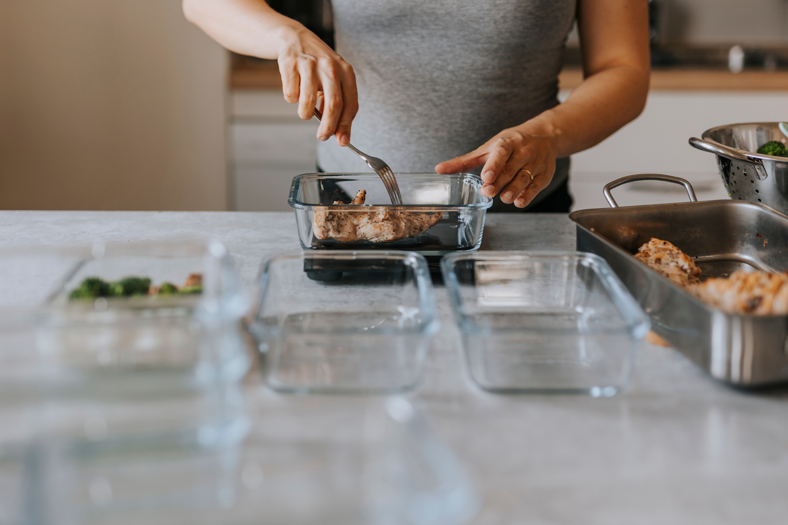
ITV Wellbeing Matters
Daily preservation
Aiming for just enough

Slide 24
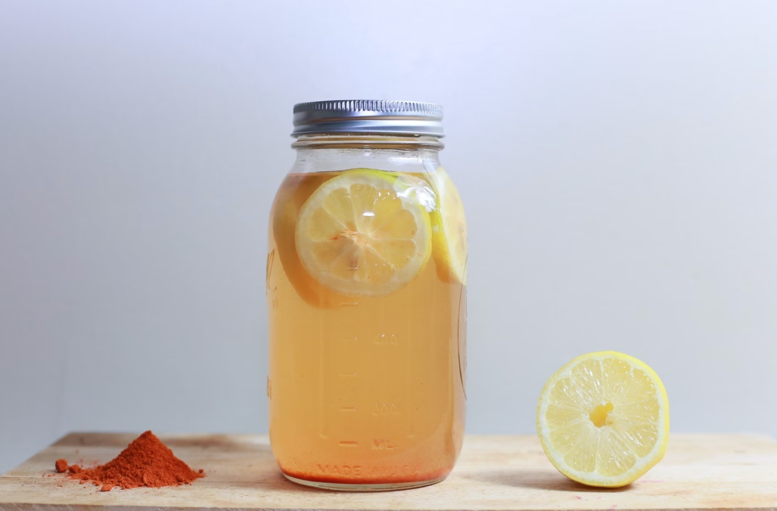
ITV Wellbeing Matters
Exploration and experimentation
Questioning the status quo

Slide 25
ITV Wellbeing Matters
Hungry for more?
Lucy Irving
Tom Anderson
Senior Cultural Strategist
lucy.irving@itv.com
Creative Strategist
tom.anderson@itv.com

