Slide 1


DRIVING VALUE BEYOND PRICE

Slide 2
Highly cautious spending
APRIL CAUTIOUS SPENDING, FEWER CONCERNS 12% | APRIL CAUTIOUS AND CONCERNED 34%
APRIL FEELING RELAXED 39% | APRIL LESS CAUTIOUS BUT CONCERNED 15%
OCTOBER CAUTIOUS SPENDING, FEWER CONCERNS 9% (-3) | OCTOBER CAUTIOUS AND CONCERNED 46% (+12)
OCTOBER FEELING RELAXED 30% (-9) | OCTOBER LESS CAUTIOUS BUT CONCERNED 15%
Fewer future financial concerns
More future financial concerns
Less cautious spending

Slide 3
PRICE IS IMPORTANT BUT
IT’S NOT THE BE ALL AND END ALL
Which of the following do you consider when assessing good value?
[Price only]
Supermarket
Food & Drink
Fashion
Telco
Agree %
Beauty
Total Average
75
80
85
90
95
100

Slide 4
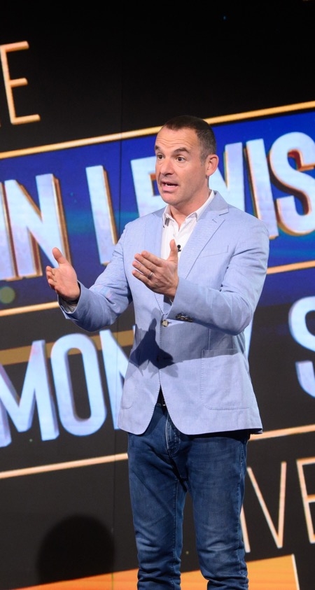
“FAIRNESS” IS A UNIQUELY BRITISH CONCEPT, AND UNDERPINS OUR UNDERSTANDING OF VALUE
“Because everyone is tightening their belts. We need to know what we pay for is worth as much as we can afford. I don’t want to pay over the odds for something that is half the size it was a year ago.”
Female, 35-54

Slide 5
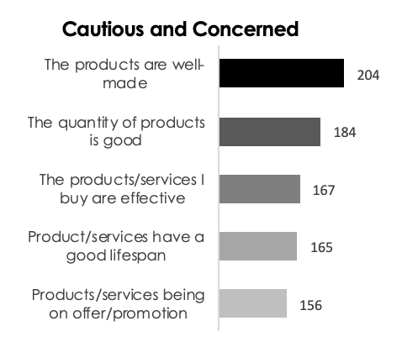
“IN MOMENTS OF HEIGHTENED RISK AND UNCERTAINTY, HUMANS USE “FITNESS SIGNALS” TO MITIGATE RISK AND INFORM THEIR DECISIONS”.
Ian Murray, House51
Fitness signals = financial strength, product confidence, and quality

Slide 6



































Self-
Transcendence
Social-impact elements
Self-actualisation
Motivation
Heirloom
ULTIMATELY, WE DON’T MIND PAYING MORE FOR SOMETHING IF IT MAKES US
FEEL GOOD
Life-changing elements
Affiliation & belonging
Provides
Hope
Nostalgia
Design/ Aesthetics
Rewards
Badge Value
Reduces
Anxiety
Attractiveness
Wellness
Emotional elements
Access
Entertainment
Therapeutic Value
Makes
Money
Reduces Risk
Organises
Simplifies
Integrates
Functional
elements
Saves Time
Quality
Connects
Reduces Cost
Variety
Avoids
Hassles
Sensory
Appeal
Reduces
Effort
Informs
Notes:
clare miller: “Attitudes to spending have changed.
We are saving up for moments - time is more important. There’s been a gear change in perspective in what now matters.
Less volume, more value”

Slide 7




VIEWERS ASSESS VALUE DEPENDING ON WHAT CATEGORY THEY ARE SHOPPING IN
Beauty
Efficacy
Fashion
Durability
Telecomms
Service
Supermarkets
…Everything!

Slide 8

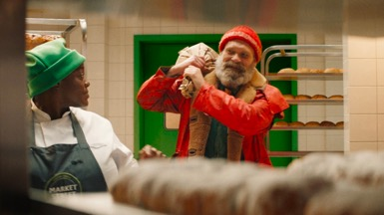

SUPERMARKETS NEED TO GIVE
POWER TO THE PEOPLE
Show us we can
dream of more
Pull the rug out from under the competition
Shine a light on the extra mile

Slide 9
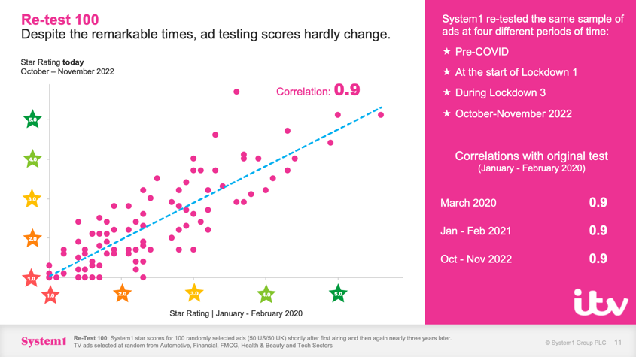
IN 2023, THE MOST EFFECTIVE BRANDS ENTERTAIN WITH EMPATHY

Slide 10




ENTERTAIN WITH EMPATHY,
USING THE CODES OF YOUR CATEGORY
Supermarkets
‘Power to the people’
Food & Drink
‘Revelling in
the moment’
Fashion
‘Supporting main character moments’
Telecomms
‘Common sense connectivity’
Beauty
‘Beauty you can believe in’
Travel
‘Appreciate my need to escape’
Home
‘Little lifts, big impacts’
Subscriptions
‘Elevate life’s essentials’

Slide 11
ASK YOUR ITV CONTACT FOR A BESPOKE SESSION

