Slide 1
Don’t panic!
January 2023

Slide 2
The recession will be mild
Advertising can still help
Scenario planning is possible

Slide 3
The recession will be mild

Slide 4
No-one’s got a crystal ball
But the majority of forecasts are for a mild recession by historical standards

Slide 5
No-one’s got a crystal ball
But the majority of forecasts are for a mild recession by historical standards

Slide 6
Advertising can still help

Slide 7
The historical evidence for “don’t go dark” is conclusive
Businesses that kept advertising outperformed those that stopped
Sales and share for those that kept advertising vs. those that stopped
(academic studies)
1920s:
+20% sales
1970s:
+40% sales
1980s:
+50% sales
+1% share
1990s:
+20% sales
+1% share
2000s:
+20% sales
+3.5% share
(awards)
2010s:
?% sales
+3.5% share
2020s:
?

Slide 8
In our more recent and nuanced study, “don’t go dark” still applies
Study of survivors and thrivers in the COVID recession shows they continued to invest
Survivors & thrivers advertising budget as a % of turnover during COVID
Companies that survived even though they were in “in person” sectors that were badly affected e.g. transport, durables
Companies that thrived in sectors like FMCG and Financial Services that weren’t too badly affected by COVID and recession
Companies that grew quickly in a sector that actually benefitted from COVID, e-commerce and direct to consumer
Average pre-COVID = 12%

Slide 9
Close up on FMCG during COVID: Cheap share of voice was available
Some advertisers took advantage by increasing their spend

Slide 10
This strategy worked
The bigger spenders saw better uplifts and higher ROI

Slide 11
But “don’t go dark” is too blunt as a universal piece of advice
It matters what’s going to happen to demand in your particular sector
If your sector will benefit: “don’t go dark” is too conservative You can make big bets in your advertising plan
If your sector is secure: Look for low-cost media buys to get extra share of voice for cheap and high ROI campaigns
If your sector will be a victim: “don’t go dark” might be flat out wrong. You need to do some maths to know what to do

Slide 12
Scenario planning is possible

Slide 13
Doing the maths
To get the confidence that you’ll get the payback
Others go quiet
Cheap share of voice
Share of market later on
So share of voice has to be really very cheap to ensure payback, and it may not be!
In victim sectors the sector is smaller and may stay smaller, so this is a slice of a smaller pie

Slide 14
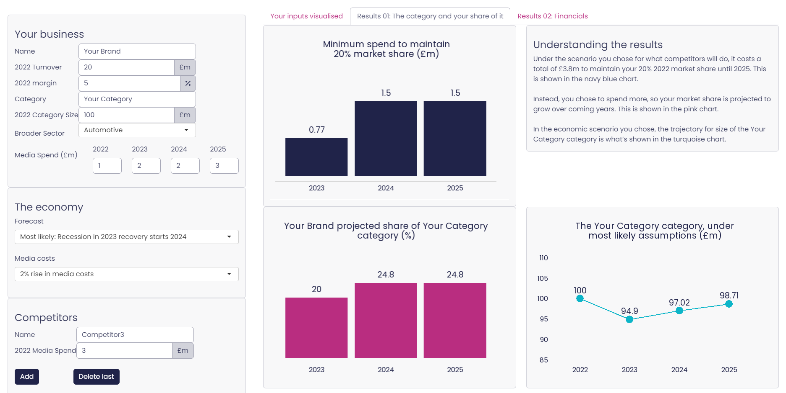
Sneak peek of the tool
It’ll be going live in the coming weeks

