Slide 1


DRIVING VALUE BEYOND PRICE
Notes:
Welcome.
Our third part of our ongoing research into the cost of living crisis and how its playing out in the shelves, homes and spirit of the nation.
We started this in april 2022, just after the invasion of Ukraine, tracked again in October in 2022 - just after that horrific leap in energy prices…and now here we are, autumn 2023 - and this time, things look quite different.

Slide 2
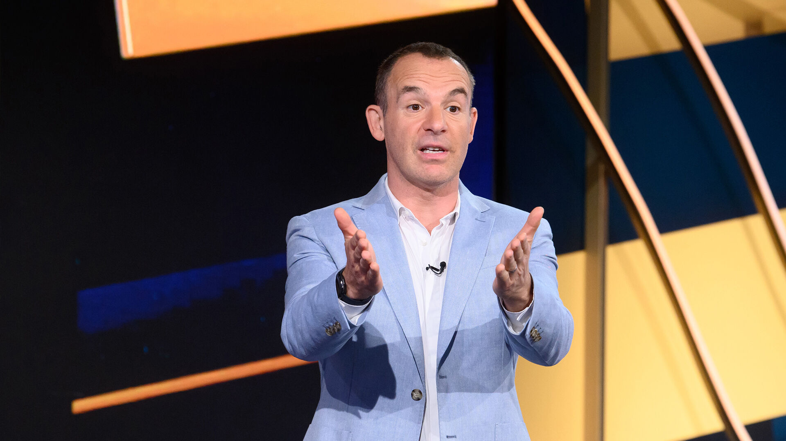
Power to the people
Wave Three:
POWER TO
THE PEOPLE
Notes:
We’ve somewhat settled into our new normal.
We are sharper, savvier, more self reflective than before.
More time researching
Doing more hard yards
Reaping more benefits
…but it’s all on us

Slide 3



Wave three
NEW YEAR - NEW SENSIBILITIES?
1
2
3
ITV’s Mainstream Audience Segmentation
Continued tracking of the ITV’s unique segmentation, plus a deep dive into what value means by category.
(n=2,427/116)
Mood
Explore and understand the current mood of mainstream audiences around the economy and its impact on their buying behaviours now
and in the future.
Permanency
Explore and unearth the key motivations that drive trading up/down and brand switching behaviours in general within five categories. Supermarkets Food & Drink, Telcos, Wellness, Retail and Travel.
Notes:
This time around as well as updating our tracker - exploring how people are feeling about their finances and what are their spending intentions, we also updated our deep dive into what value means within different categories, from supermarkets to telcos. But this time around we were chasing what we thought might be a bit of a pipe dream - is there a glimmer of hope on the horizon? And what new behaviours and brands have people experienced as a result of the cost of living crisis, and are they here to stay?

Slide 4
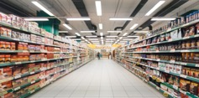
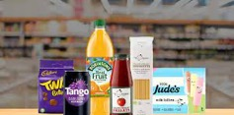


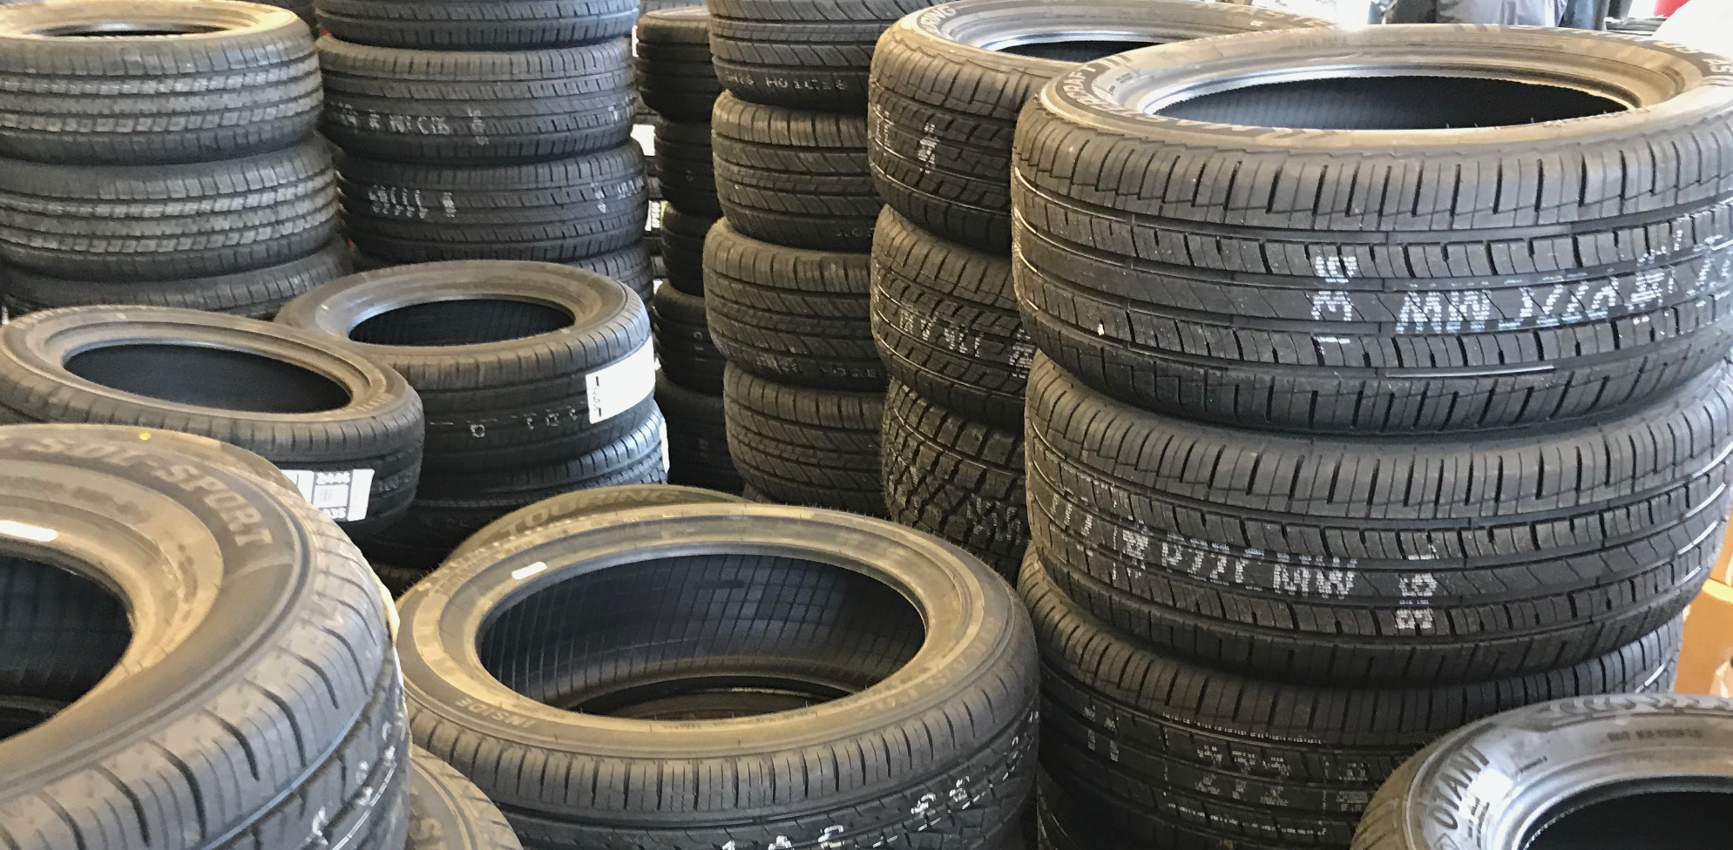




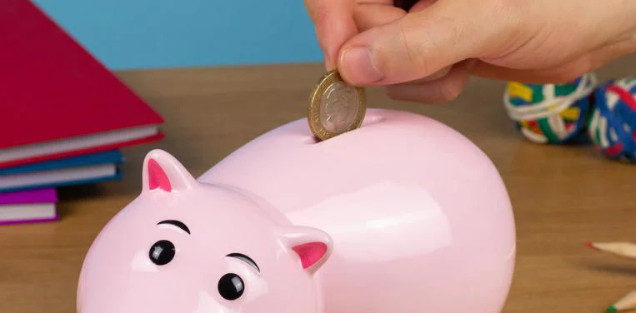
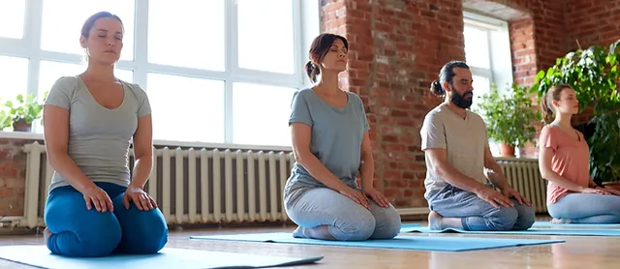
What does value mean?
EXPLORING WHAT VALUE MEANS ACROSS 10 11 CATEGORIES
Supermarkets
Food & Drink
Fashion
Telecomms
Automotive
Beauty
Travel
Home
Subscriptions
Finance
…and now …wellbeing
Notes:
What makes this research different from other cost of living pieces is that we have been getting under the skin of what value means in different categories. This year, we have added wellness as a new category, given its swing into mainstream culture and shopping baskets.
In november last year, we profiled the concept of value within 10 different categories. What surprised us was that, whilst price was undoubtedly important, value actually means very many - and very many different things depending on what mainstreamers are shopping for. For food and drink, its all about those everyday sparks of joy - so quality is king. For fashion, it is durability, for travel, beauty and telcos, it is trust.
But most interestingly, supermarkets - the most dynamic of our categories, with almost every single value driver disproportionately important. We summarised supermarkets as needing to give power to the people.
And, in this most recent wave, we’ve found that that sentiment of power to the people applies to everything, everywhere, and everyone.

Slide 5
Mainstream Audience Segmentation
THE PRESSURES ON CONSUMERS APPEAR TO HAVE EASED, RETURN TO SIMILAR LEVELS OBSERVED IN WAVE ONE
Highly cautious spending
APRIL ‘22 CAUTIOUS SPENDING, FEWER CONCERNS 12% | APRIL ‘22 CAUTIOUS AND CONCERNED 34%
APRIL ‘22 FEELING RELAXED 39% | APRIL ‘22 LESS CAUTIOUS BUT CONCERNED 15%
OCTOBER ‘22 CAUTIOUS SPENDING, FEWER CONCERNS 9% (-3) | OCTOBER ‘22 CAUTIOUS AND CONCERNED 46% (+12)
OCTOBER ‘22 FEELING RELAXED 30% (-9) | OCTOBER ‘22 LESS CAUTIOUS BUT CONCERNED 15% (=)
AUGUST ‘23 CAUTIOUS SPENDING, FEWER CONCERNS 10% (+1) | AUGUST ‘23 CAUTIOUS AND CONCERNED 34% (-12)
AUGUST ‘23 FEELING RELAXED 41% (+11) | AUGUST ‘23 LESS CAUTIOUS BUT CONCERNED 15% (=)
Fewer future financial concerns
More future financial concerns
Less cautious spending
Source: Q2. Thinking about your attitude towards finances for the rest of the year, where would you say you sit on the following scales? Base: Total (n=2,427)
Notes:
April - ukraine war, not necessarily feeling the effects. Post covid jubliance still in the air
October - energy price rises, interest rates on the climb
Aug - a welcome return to feeling relaxed

Slide 6
Switching Behaviours
MOST CONSUMERS HAVE SWITCHED PRODUCTS/SERVICES DUE TO PRICE INCREASES
“If I see a new product/service that is equal quality but cheaper, I will switch. Equally, if I see a new product/service of better quality for the same price, I will also switch.” F, 62
84%
switch due to
rising prices
Source: The Importance of Value Survey
Q18. Thinking about the cost of living crisis, which, of the following statements best represents how you’ve switched products/services within [pipe: Cell_Recoder]?/ Q18b. How frequently have you switched [pipe: Cell_Recoder] products/services in response to rising prices?/ Q18c. How likely are you to continue using the same [pipe: Cell_Recoder] products/services even if their prices continue to rise?
Base: Total (n=2,427)
Notes:
Significantly higher among Cautious and Concerned (88%)
and those Less Cautious but Concerned (87%

Slide 7



































The dynamics of value
Self-
Transcendence
Social-impact
elements
Self-actualisation
Motivation
Heirloom
Life-changing
elements
Affiliation & belonging
Provides
Hope
WE’VE BECOME VERY COMFORTABLE WITH THE MANY DIFFERENT FACETS OF VALUE
Nostalgia
Design/
Aesthetics
Rewards
Badge
Value
Reduces
Anxiety
Attractiveness
Wellness
Emotional
elements
Access
Entertainment
Therapeutic Value
Makes
Money
Reduces
Risk
Organises
Simplifies
Integrates
Functional
elements
Saves Time
Quality
Connects
Reduces Cost
Variety
Avoids
Hassles
Sensory
Appeal
Reduces
Effort
Informs
Notes:
All of this creates a new, dynamic and strong creative playground for brands, ITV and our audience. We have permission to have fun, to empower and embolden our audience. Brands and ITV have a role to play in providing fun, inspiration, relaxation and optimism for our audience.
55% of people say value is more important to them than it was a year ago, down significantly from 67% when asked in 2022
With the cost of living crisis and general price increases, people are becoming more accustomed to living with less disposable income. While the proportion of people saying value is more important to them is down vs. last year, purchases are more considered.
Key shifts in the pyramid are: 9% make life more fun, 10% broaden my horizons, +9% environment, +7% keep me organised.

Slide 8
A change in perspective
AT THE HEART OF THE SHIFT,
A CHANGE IN PERSPECTIVE
COMFORTABLE JUST DOING ME
Notes:
At the heart of this change sits a shift in perspective
As we’ve become even more comfortable with relying solely on ourselves to navigate the best course of action

Slide 9
A change in perspective
ONE CENTRAL SHIFT,
FIVE DIFFERENT EXPRESSIONS
COMFORTABLE JUST DOING ME
THE PRIDE OF SELF-RELIANCE
FLIP-FLOPPING AROUND
SUBURGATORY RULES
CONSCIOUS DECISION MAKING
WHO SAYS I CAN’T?
Notes:
That independent spirit we see play out in 5 different ways
Self-reliance, self-confidence and even at times, self-indulgence.
Our viewers have told us they’ve become extremely comfortable with making their own minds up on things
Making the best decisions for theme

Slide 10
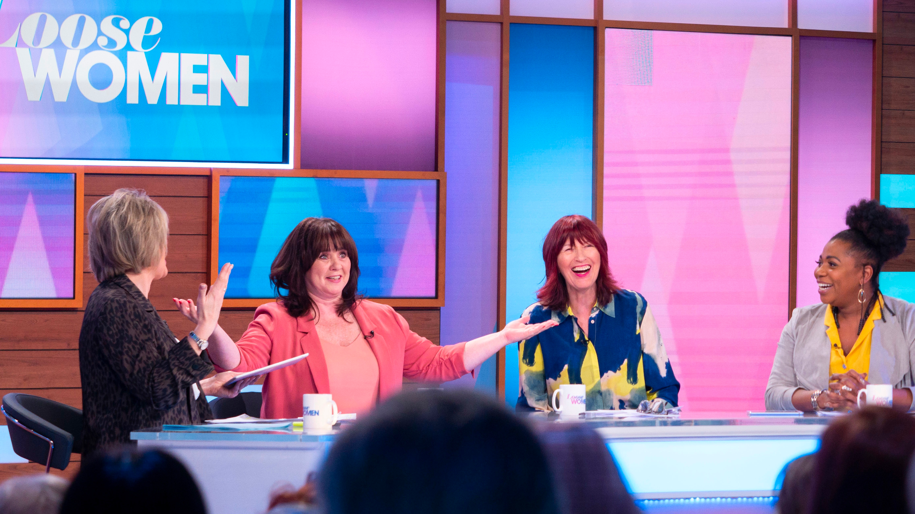
Self-reliance
THE PRIDE OF SELF-RELIANCE
Notes:
Allowing ourselves to take a bit of pride in how we’ve coped the last 7 or 8 months

Slide 11
Self-reliance
WE’RE PROUD AT HOW WE’VE BEEN ABLE TO SIMPLY KEEP GOING
“Hopefully [things will get] better since I work so hard to make ends meet and doing quite well.Planning to see more family this year so will be spending a lot more than last year and will be saving more for that.
You can only hope for the best otherwise you will be depressed and worried.”
M, 35, London
“I’m old enough to remember strikes and powercuts and was brought up with the make do and mend approach. As much as I hated it then it s serving me very well now and I know I have hidden strength and all will be ok.”
F, 57, West Country
“Financially I feel confident that I will cope positively over the next year and beyond. Not sure what I shall be doing at Christmas, as an unknown factor at this moment. The future I shall make as good and as positive as I can. The only way is up!”
F, 76, East
Notes:
Our viewers spoke about 2022 in terms of difficulty and survival…but laced between all of this, were feelings of real pride. \
working hard and doing well / Hidden strength / the only way is…not essex, the only way is up.
We’ve kept going
We’ve found a way
We’ve kept smiling through
Found a resilience that perhaps was untapped for a while
Feeling somewhat more confident about the future

Slide 12
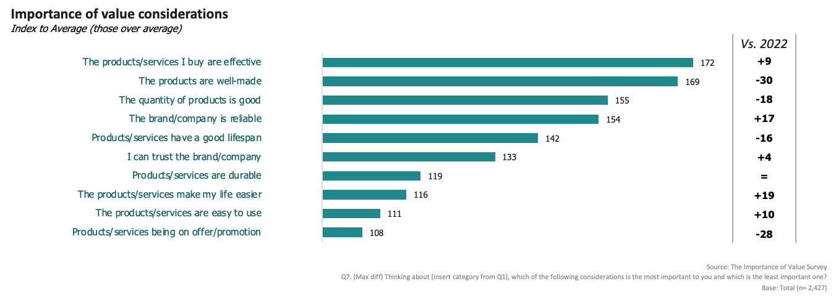
Self-reliance
Relative to 2022, we place far greater importance on trust and reliability
Notes:
Reassessed what we place importance on
Not just about price, but about trust & reliability
In every sense of the word - rely on you not to let me down, trust you to not do horrible things to the planet

Slide 13
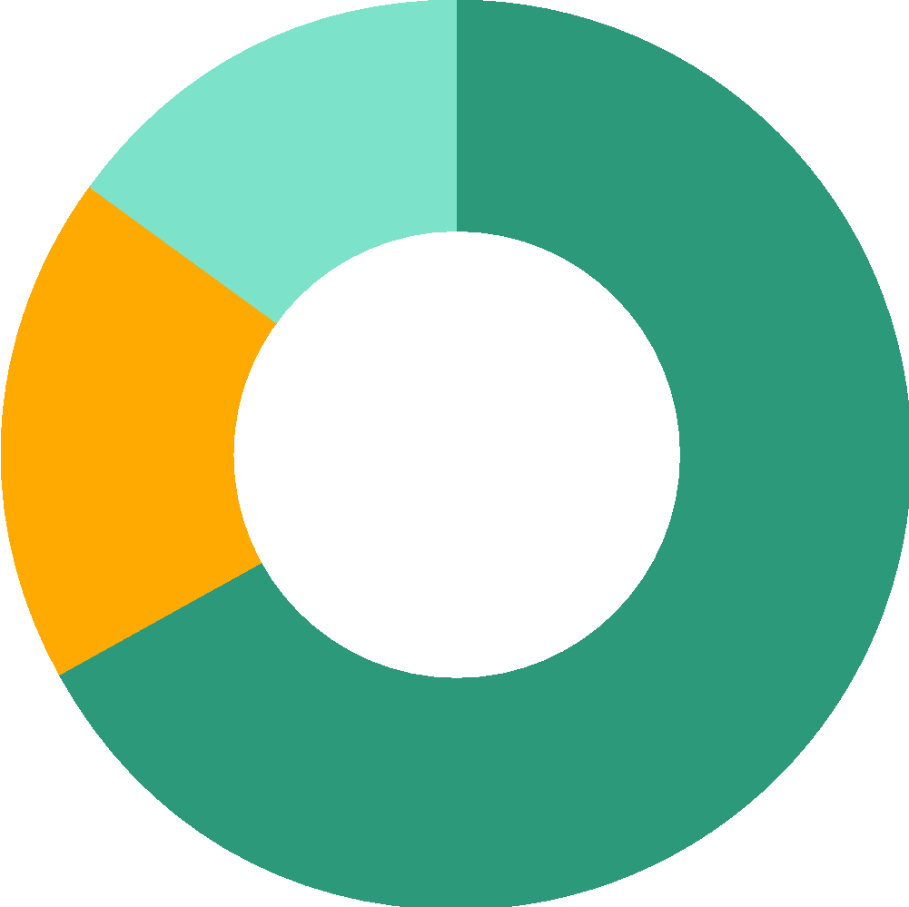
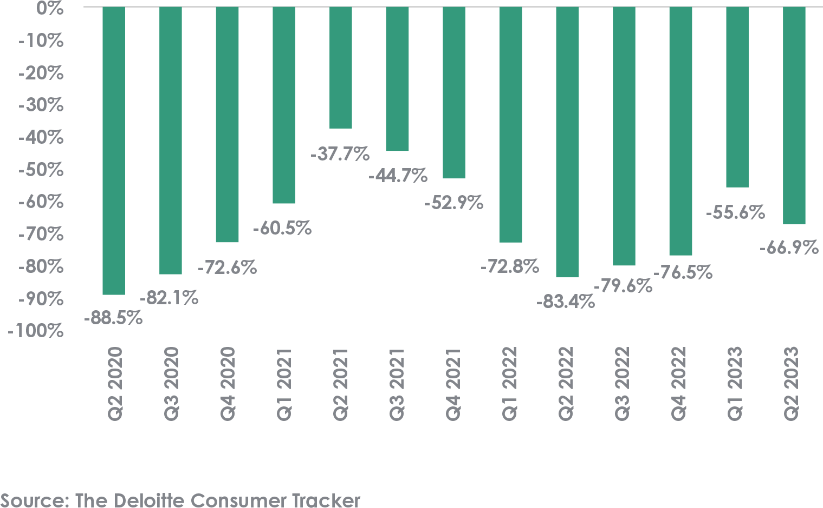
Self-reliance
IN SPITE OF A TOUGH YEAR WE’RE STILL SATISFIED WITH HOW WE’RE DOING AND WHERE THE COUNTRY IS GOING
“I feel satisfied that the things I do in my life are worthwhile”
Net % of UK consumers who said that their confidence in the state of the UK economy has improved in the past three months
15%
18%
67%
Agree
Neutral
Dissagree
Notes:
Despite how tough the year has been, we’re still maintaining positivity
Satisfied with where we are in life
More confident that the economy will survive

Slide 14

Making our own minds up
FLIP-FLOPPING AROUND
Notes:
More time researching
Doing more hard yards
Reaping more benefits
…but it’s all on us

Slide 15
Making our own minds up
RISING PRICES: STICK OR TWIST?
Supermarkets/
Food & Drink
“Things have become so much more expensive overall, if I can get the same quality for a lower price, I will switch. We cannot afford to be loyal to brands anymore.”
Female, 55+, Less Cautious but Concerned
Telcos
Wellness
Discretionary
Retail
Travel
Likelihood to switch
Likelihood to stick
Notes:
Across different categories we saw different propensity to switch & stick
Supermarkets & Retail suffering most

Slide 16
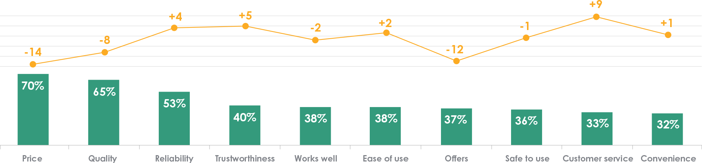
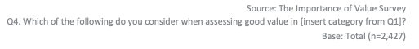
Making our own minds up
PRICE IS LESS IMPORTANT THAN IT WAS
Considerations when assessing good value (top 10)
By total
Change vs November 2022
Total
Change
Notes:
We place less importance on price than we did last year
We’ve come to terms with the importance of other facets of value, like reliability & trust

Slide 17
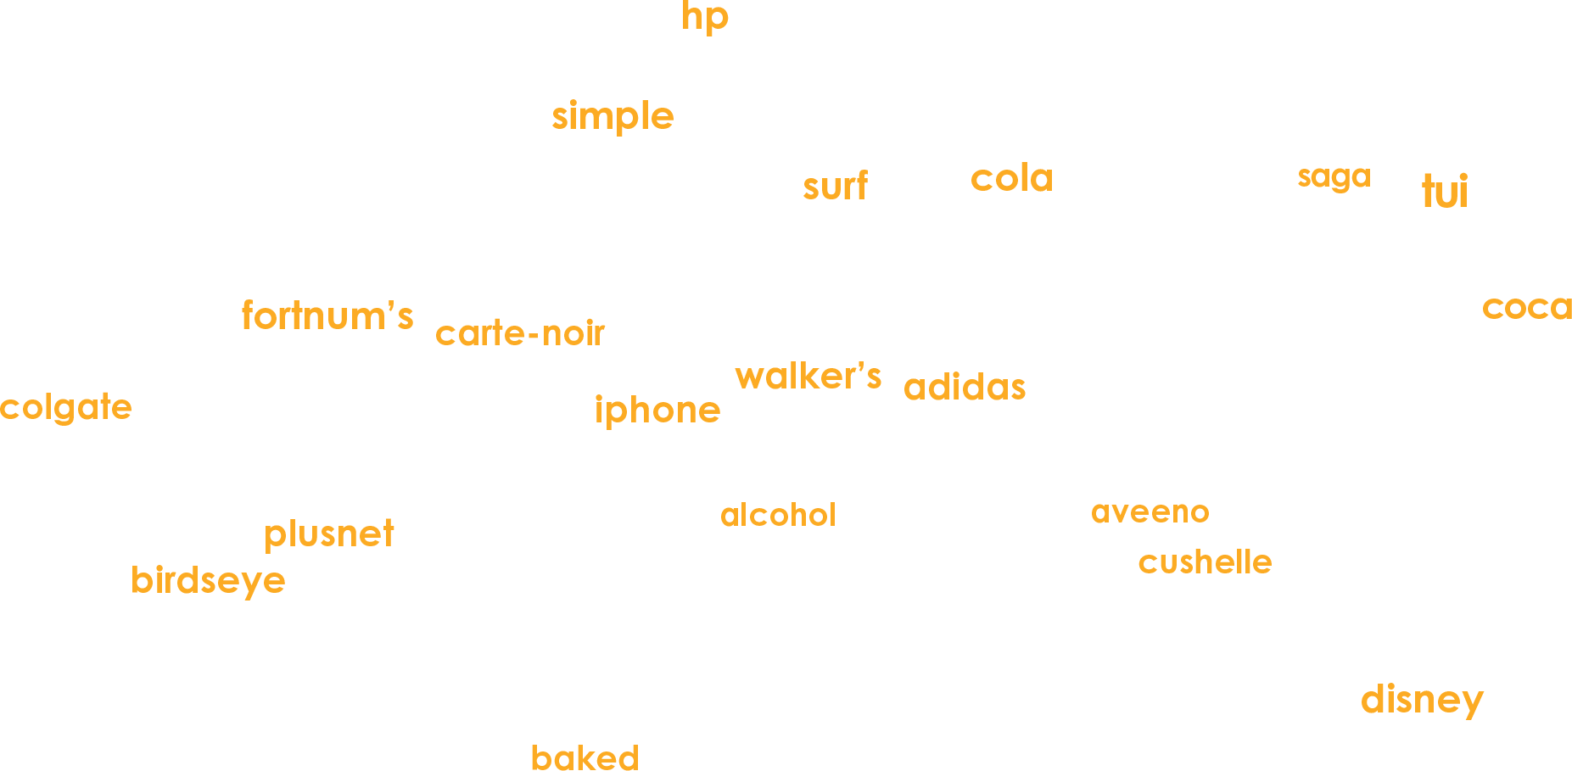
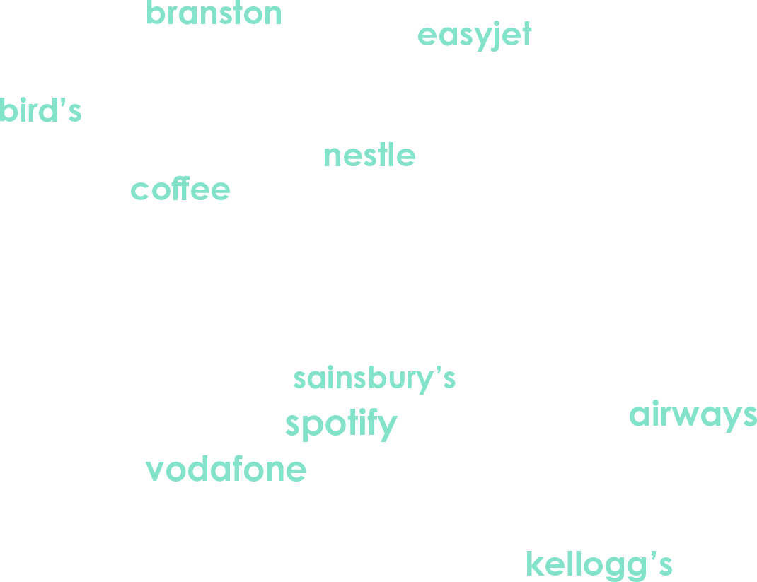
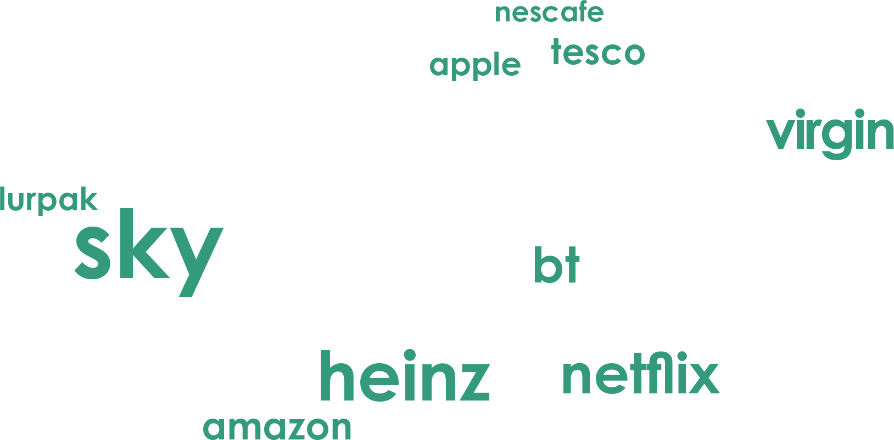
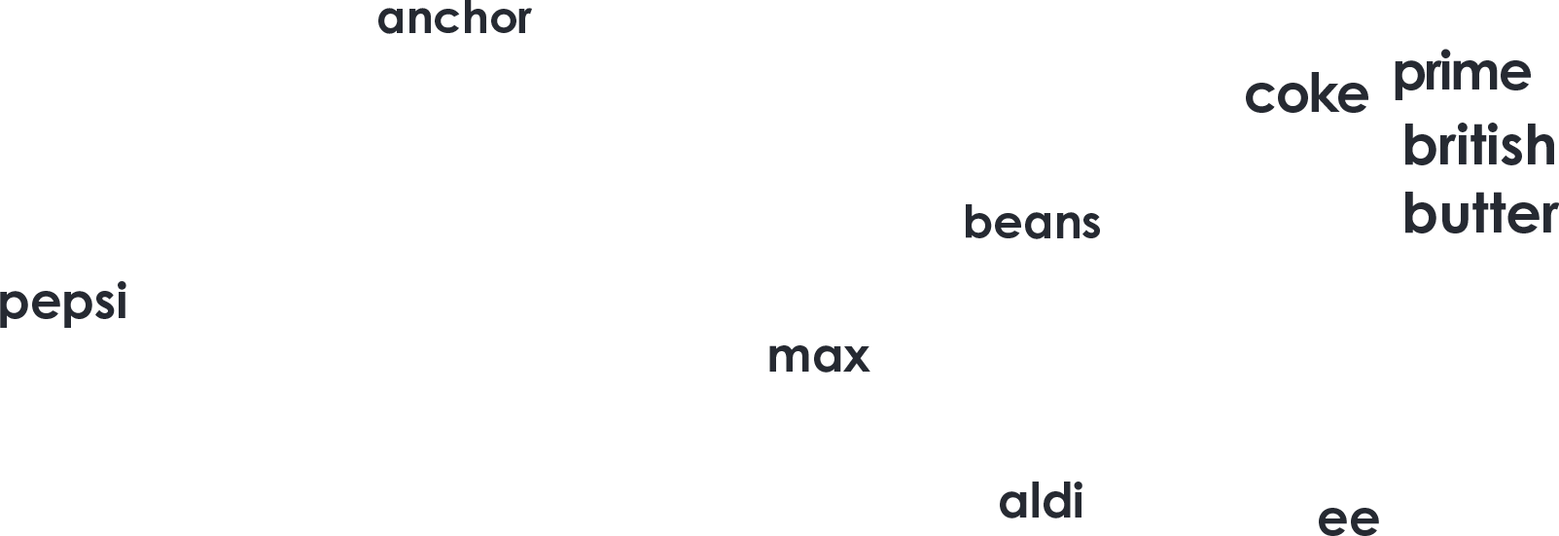
Making our own minds up
ALL OF WHICH MEANS WE CAN PRESERVE WHAT MATTERS TO US
“I'm still buying my favourite brands as I always have. I have NEVER switched to another brand and been satisfied. Bread must be Warburtons, crisps must be Seabrooks, crisp like snacks such as Quavers and Wotsits must be Walkers, margarine must be Stork and cream crackers have to be Jacob's.”
M, 55-64
Notes:
And our willingness to work to find and manage budgets allow us to preserve the little things that matter
Sky
Heinz
Virgin Media!

Slide 18
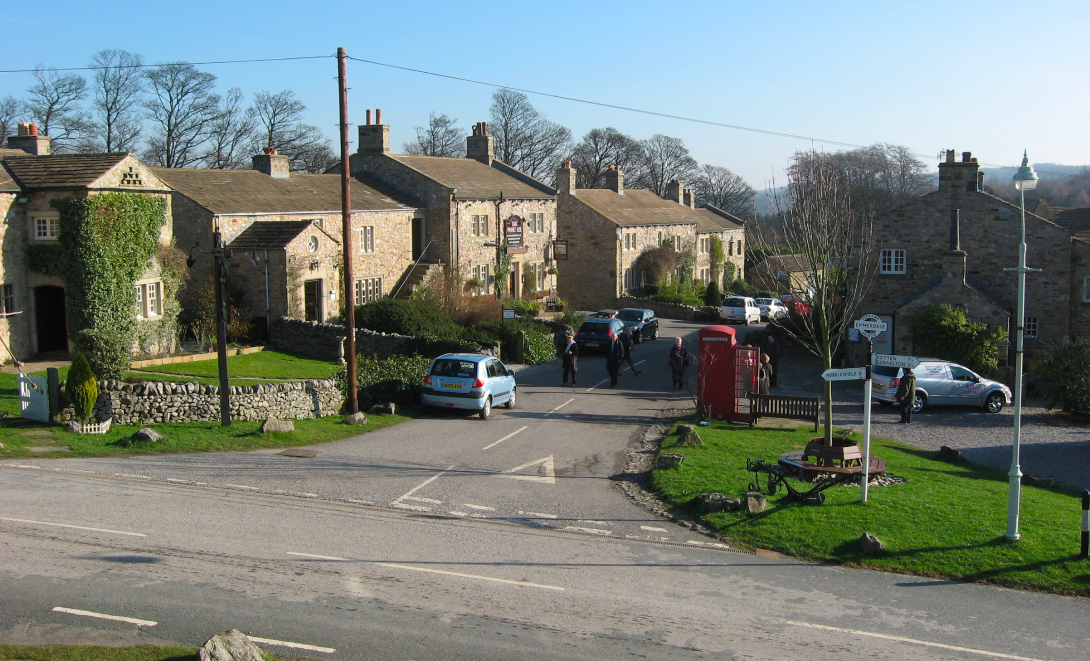
Comfortable with life
SUBURBGATORY RULES
Notes:
The next theme is all about life in the suburbs and the fringes. Days here might not be quite so full of murder and adultery as good old Emerdale, but there is still plenty to keep us fulfilled during the COLC.

Slide 19
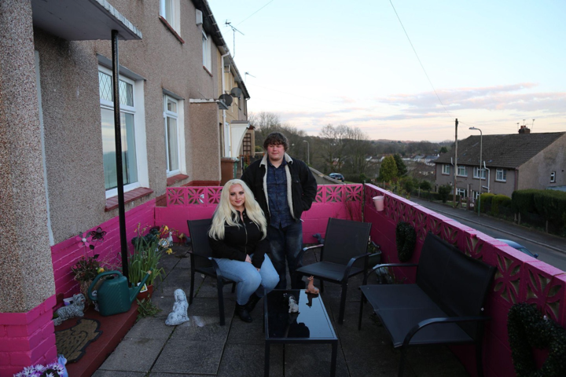
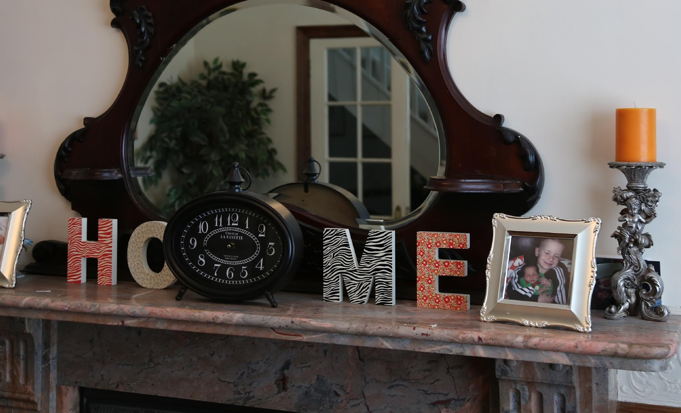
Comfortable with life
SUBURGATORY =
SURBURBAN PURGATORY
“Life in the suburbs that is very laid back and boring”
(Collins, new word suggestion, 2013)
Notes:
But first - that word.
Actually what we’ve been finding over the last 12 months of exploring mainstream households is that there is a real pride, comfort, and creativity that underpins suburbgatory these days and its been absolutely escalated since covid.
There’s a growing rejection of a sense of needing to strive upwards, of a sense of being anti-boring. Actually - we are ok as we are, thanks very much.

Slide 20
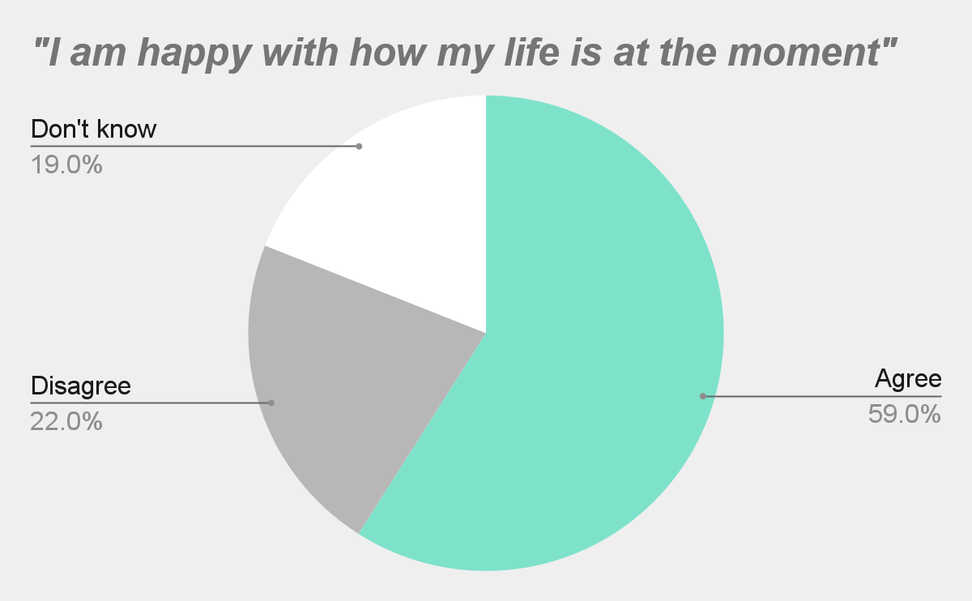
Comfortable with life
WE’RE OK AS WE ARE, THANKS
Growing rejection of feeling one has to strive to feel satisfied
Rejection of the establishment
Pride in the pack
+9% growing importance in fun
“I have my up and down days but happy that Burnley are back in the premier league and that my family keep me going” F,69
Notes:
Pride in how we do things. And an underpinning happiness - almost 6 in 10 of our mainstreamers feel really satisfied with their lives, despite the enormous financial pressures they are under.
And FUN and frivolity being a big part of that. We talked alot about everyday magic - and that is pulling through in spades here in relation to cost of living crisis.
I absolutely love this quote

Slide 21
Comfortable with life
PRIDE IN HOW WE DO CHRISTMAS
+7%
increased cash CONTROL
“As for Xmas, we’ll be worrying about that in November.
People will be getting less spent on them this year”
M,67
67%
want PRELOVED
“What’s giving me hope is that more and more people are trying to prevent environmental degradation where they can”
F, 34
Source: UK Finance % increase in cash payments YOY / IPA “Christmas amidst the crunch 2023”
Notes:
They will absolutely not be told how to do christmas. Christmas is a super personal concept. Thats why the asdas elf ad was the best performing last year - it showcased something that felt REAL, everyday - surbagatory. But showed how magical that can be with a little dose of festive cheer.
Christmas Its a source of pride and will be protected at all costs.
Protection - more cash - more control
And switching up whats acceptable - a real step in behaviour change - pre loved.

Slide 22
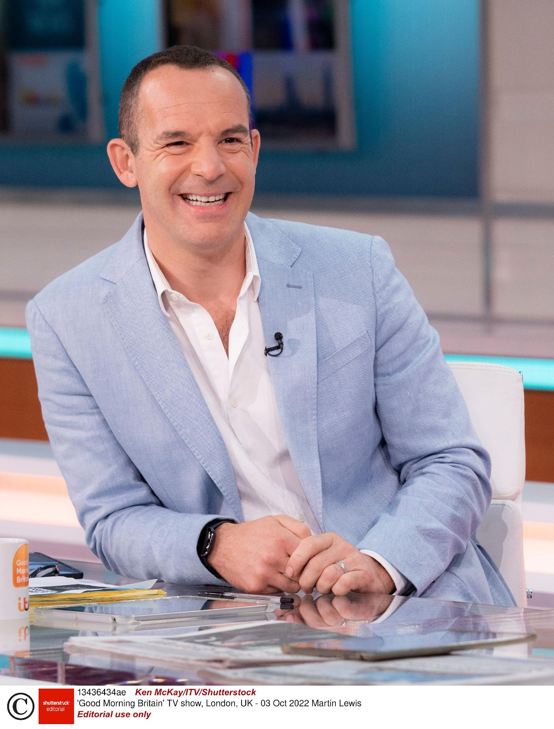
Slowing down
CONSCIOUS
DECISION MAKING
Notes:
And that sense of conscious decision making - of buying thoughtfully - was so big in this wave that it warrants its own theme.

Slide 23
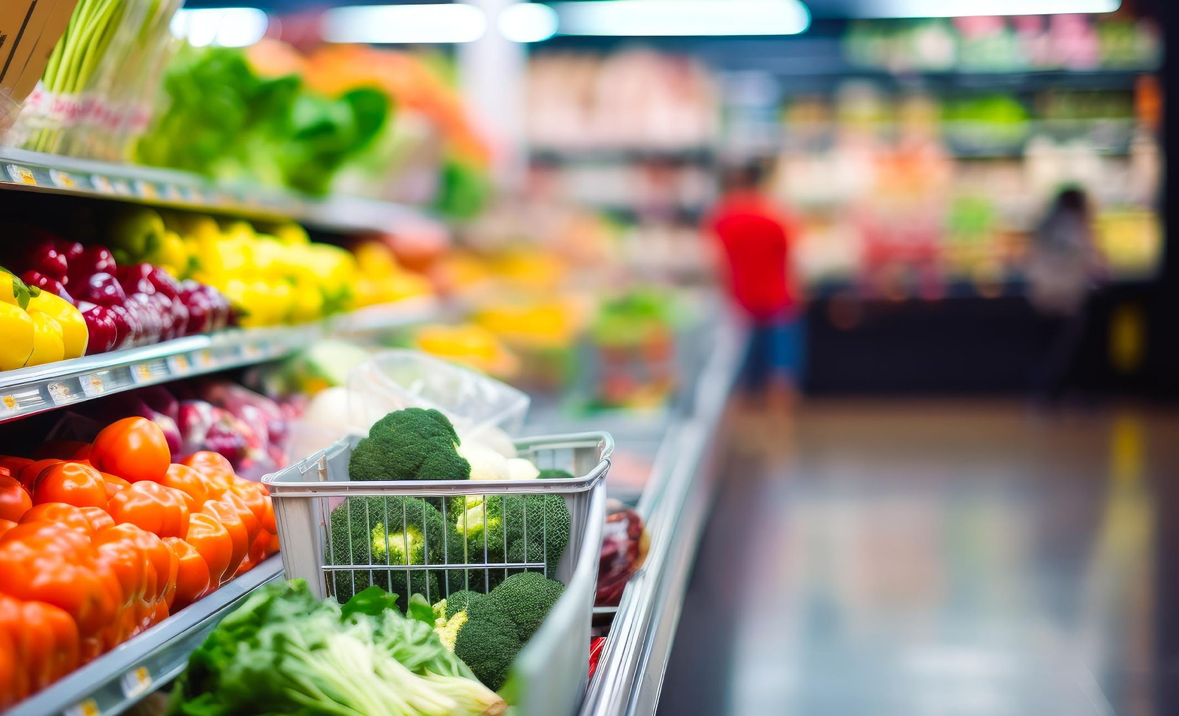
Slowing down
“Good quality food is essential. I always try to buy fresh food items, preferably British and seasonal.
I prefer to be able to select my own items.”
Male, 55+, Less Cautious but Concerned
+20%
The amount of insured cars on the road that are over 6 years old*
*Additional source = Coop Insurance, 2018 vs 2022
Notes:
And this conscious decision making really has two goals-
To save money.
To make good informed choices - whether thats environmental, lifestyle, quality or otherwise

Slide 24

Slowing down
THE COST OF LIVING CRISIS HAS DRIVEN A SLOW DOWN CULTURE
“I do some research before I purchase”
“I’m more likely to switch if I’m no longer satisfied with the product/service”
“I value products and services that broaden my horizons”
“It would be a good thing if less importance was placed on work”
82%
+19%
+10%
+65%
WANT TO FEEL WELL INFORMED
LESS DRIVEN BY PROMOTIONS
FOCUS ON CHANGING AND IMPROVING LIFE
MORE DRIVEN BY BALANCE*
*Additional Source: World Values Survey, King’s College London, 1981 vs 2022
Notes:
And this considered sensibility has, in effect, slowed things right down.
Mainstreamers will put in the hard yards to feel informed on getting the best value for the price.
But price isnt actually the thing - they are 19% more likely to switch if they find a product or service is lacking in quality vs. because of a price promotion.
But they are also looking to have their horizons broadened - improving quality of life - those moments of everyday magic, whether thats discovering a new hobby, a new taste sensation, or xxx
And this slow down culture is sharply british - we are the most likely nation - globally - to agree that less focus should be placed on work. Work life balance etc etc.

Slide 25

Slowing down
CAN WE REACH NIRVANA?
“I went to Florida with the family and whilst it was very expensive the enjoyment and satisfaction from the younger members of the family made it worthwhile ie it was good value and fair”.
David, 70.
“Something classic is worth paying for something that will last longer, but if it s something that you re guaranteed to want once then a lower cost option that is preferably not something that completely unrecyclable. Personally I don’t tend to buy many short-life clothes homeward items now”.
Female, 41.
LIVING IN THE NOW
LIVING FOR THE FUTURE
75% (+5) agree that they really value brands that provide products/services that “allow me to enjoy life”
55% (+9) agree that they really value brands that make them feel they are reducing their impact on the environment

Slide 26

An occasional bit of self-indulgence
WHO SAYS I CAN’T?
Notes:
However, there have also been times for us to embrace a feeling of…fuck it
Who says I can’t?

Slide 27
An occasional bit of self-indulgence
KEEPING A “WHO SAYS WE CAN’T?” APPROACH TO LIFE
+27%
Y.O.Y INCREASE IN HOLIDAY BOOKINGS
+1.8%
Y.O.Y. INCREASE IN RETAIL REVENUE FROM LUXURY GOODS
+12%
Y.O.Y. INCREASE IN BRITS WITH A SUBSCRIPTION SERVICE
Notes:
Who says I can’t go on holiday?
Who says I can’t tread myself?
Who says I have to cancel Spotify?
according to analysis by digital advertising platform Cardlytics
https://www.smmt.co.uk/2023/05/new-car-market-grows-for-ninth-month-running/
https://home.barclaycard/press-releases/2021/08/Subscription-Society-surges/

Slide 28
An occasional bit of self-indulgence
ASKING OURSELVES, WHAT’S LIFE WITHOUT WHIMSY?
“Magazines every week as one treat to myself”
F, 55-64
“There are loads of items i will not forego - treats and items that i will always want. Basic things like olives, a decent bottle of wine, good quality meat and fish, good quality clothing and shoes. if you make compromises on items such as these you can definitely find cheaper alternatives; however, you do get what you pay for in many instances.”
F, 35-54
“Good quality items that there are no alternative to such as Pieminster pies…they are now a treat as they are so expensive but often can be bought when on offer or multibuy.”
F, 55-64
Notes:
What is life without whimsy?
There are times when you have to say, I don’t care. I’m having a pie

Slide 29
An occasional bit of self-indulgence
WHATEVER IT LOOKS LIKE TO US, CHRISTMAS IS GETTING BOTH BARRELS
“Christmas for me is very important and this Christmas will be like all others - plenty of gifts, food and drink.”
M, 48, C2
“The cost of living is a nightmare. I can not see prices coming down but I will try and keep Christmas special.”
F, 61, C1
Notes:
And whether it’s big or small, that’s certainly going to be our attitude to Christmas

Slide 30
A change in perspective
ONE CENTRAL SHIFT,
FIVE DIFFERENT EXPRESSIONS
COMFORTABLE JUST DOING ME
THE PRIDE OF SELF-RELIANCE
FLIP-FLOPPING AROUND
SUBURGATORY RULES
CONSCIOUS DECISION MAKING
WHO SAYS I CAN’T?

Slide 31
What does value mean?
EXPLORING WHAT VALUE MEANS ACROSS 10 11 CATEGORIES
Supermarkets
Food & Drink
Fashion
Telecomms
Automotive
Beauty
Travel
Home
Subscriptions
Finance
…and now …wellbeing
Notes:
IF YOU ARE AN ADVERTISER IN ONE OF THESE CATEGORIES, WE’D LOVE TO TAKE YOU THROUGH THE RESEARCH, PLS GET IN TOUCH

Slide 32
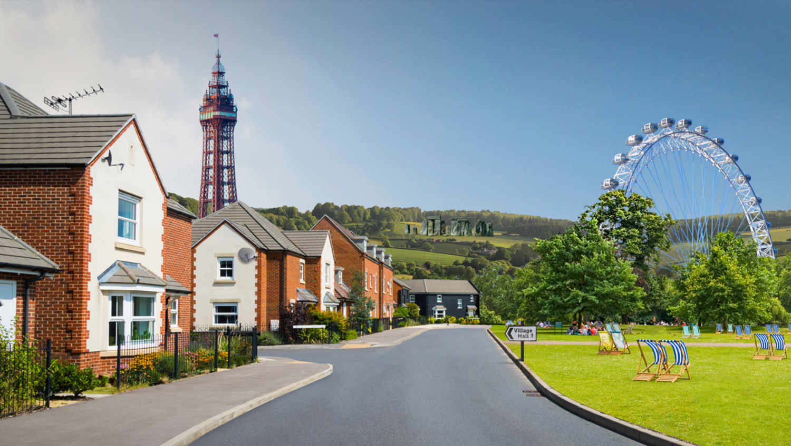
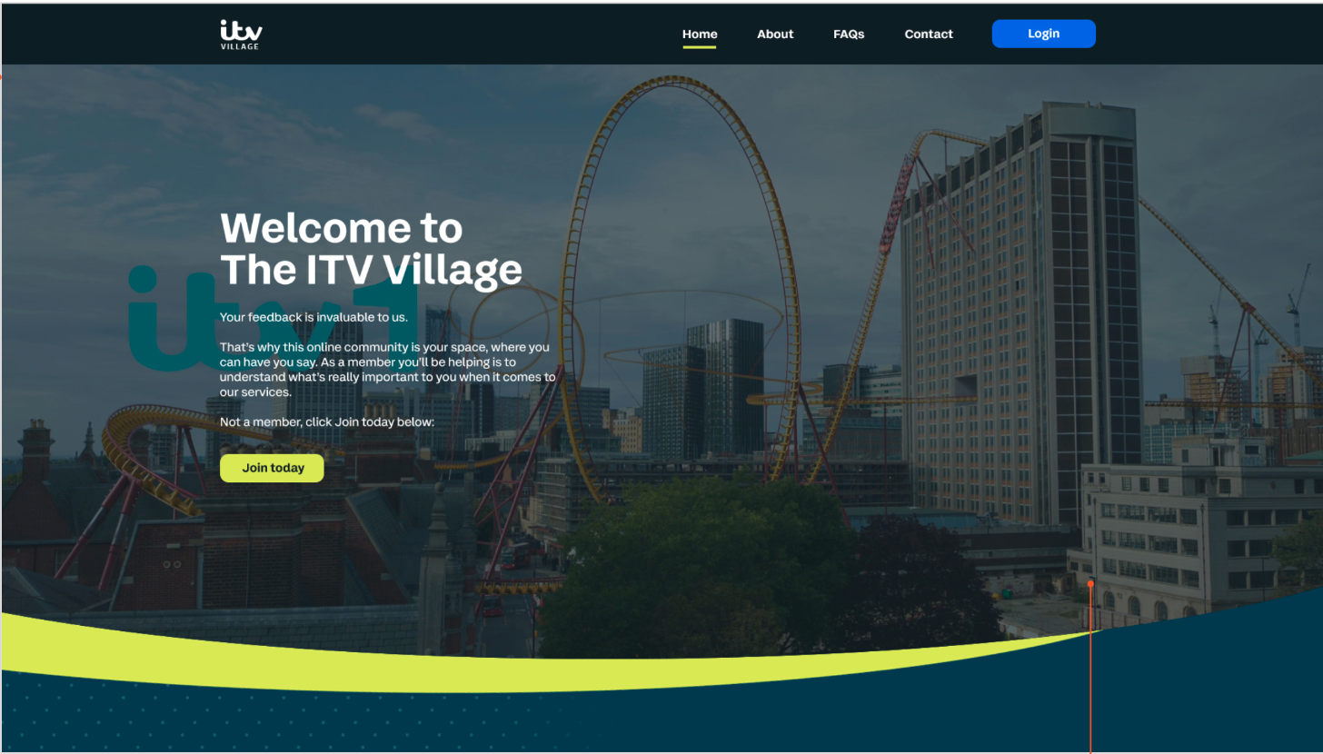

THE FUTURE
THANK YOU
Notes:
Upfront
tracking over past 18 months
are seeing a new dawn/economy emerging - more hope, more pride, more ethics
But this new dawn comes with new sensibilities - consumers are de-risking decisions than ever before. More cash transactions (bbc article)
consumers are seeing more reassurance than ever before that they are making smart decisions when it comes to value. And that is only going to increase (most people expect the importance of “value” to increase over next 12 months).
Money is not linked to happiness
We explored what is underpinning this, and what it means for different categories.
Value pyramid and the key shifts.

Slide 33
Race to the Top
Get in touch
Caroline Clear
Adam Jones
Client Strategy Controller
caroline.clear@itv.com
Senior Strategist
adam.jones1@itv.com

